Slide 1
Manage stakeholders (Pr)

Slide 2



Category
Domineering
Confusing
Unrealistic

Slide 3

How to deal with the Dominators
Meet separately to ask them hold back
Conduct round robin start at the end opposite from the dominator
Stand up to regain control or focus if needed
Repeat/validate the points & write them down
Pivot the conversation to ask for solution
Brain writing

Slide 4
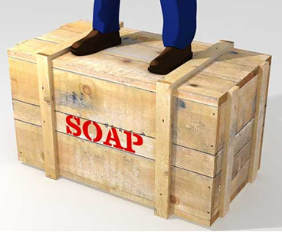
How to deal with confusing stakeholder
Clarify early & often. Identify in-scope items and out-of-scope items
Identify their “soap box issue” early and emphasize WIIFT (What’s In It For Them). Ask for explanation about motivation/ driving factor
Ask stakeholders to prioritize cost, time, and scope
Explicitly ask how they will define success. Always ask stakeholders to finish this sentence: “I will consider this project a success if…”

Slide 5
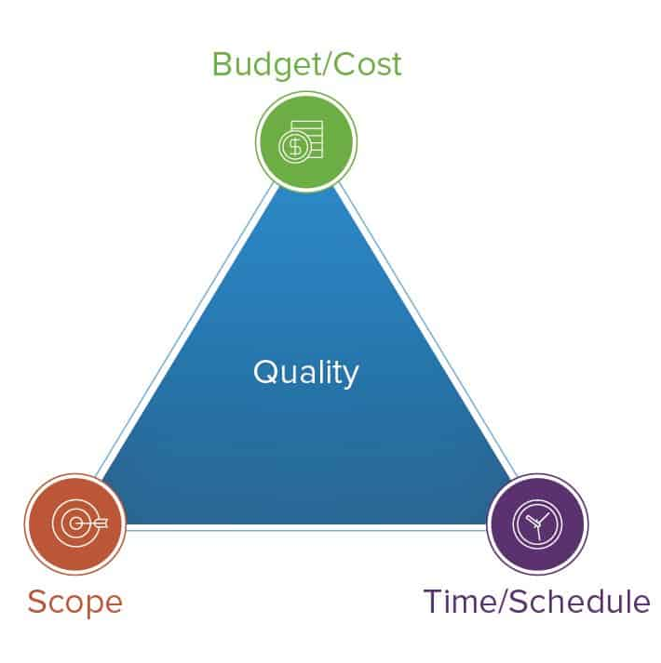
How to deal with unrealistic stakeholder
Identify the specific mandatory requirements (and separate the “wants” from the “needs”).
Document your risk analysis. Check with the stakeholder to ensure that he or she is comfortable with that level of risk.
Remember the “triple constraint”
Push back if the stakeholder’s expectations are just not realistic

Slide 6

Duy’s questions
How can we choose best technique suited for producing results when preparing for elicitation? Frequent technique used for elicitation?
When preparing for elicitation, we need to have a preparation guides about the scope and purpose of elicitation activities. What are the basic information needed for the guides?
Do we have questions as additional support for this guide?
What happen if the elicitation comes out of scope? How do we prevent from going out of scope?

